Slide 1

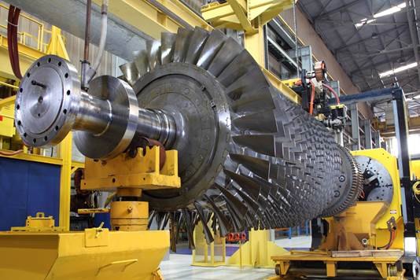
MiniLab Series for Industrial Plants
March 2016

Slide 2
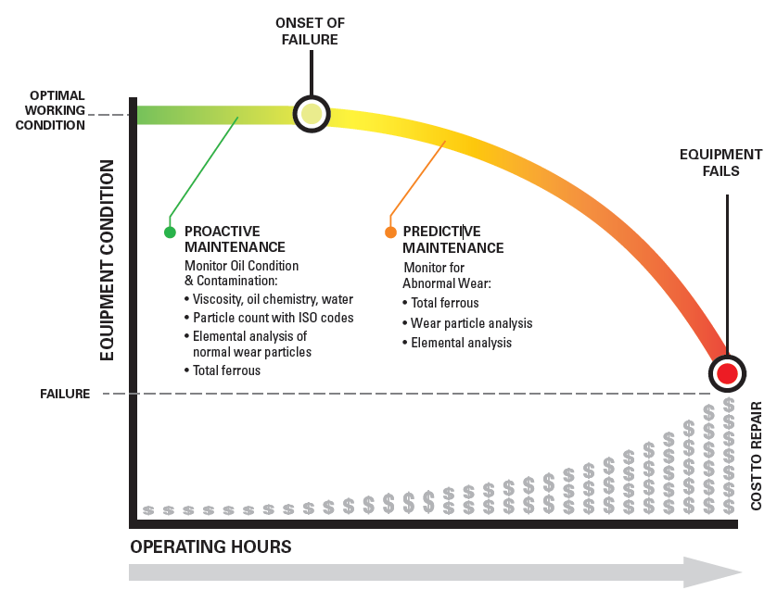
In service oil analysis for Machine Condition Monitoring
Early identification and trending of machinery wear and failure modes allows maintenance before catastrophic failure occurs.
Oil analysis complements vibration, thermography and other predictive technologies
Increases confidence in decision to remove machinery from service.

Slide 3
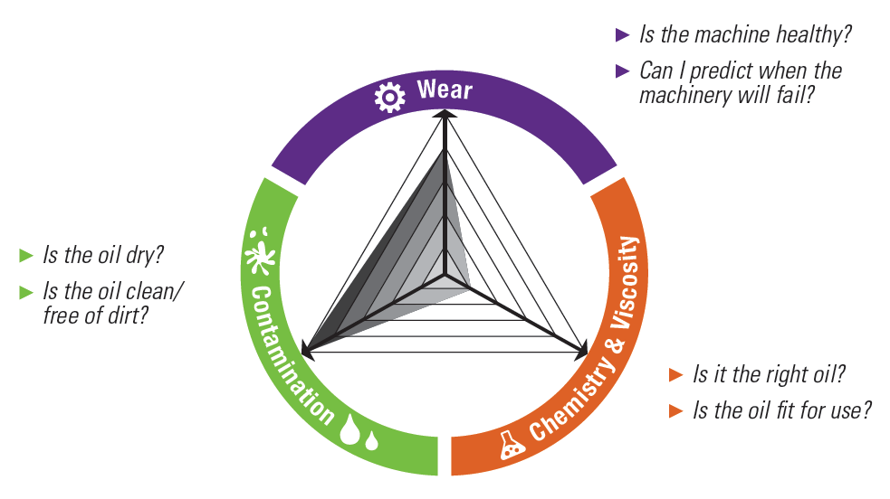
Oil Analysis answers the critical questions ...
Trivector graph of machinery health

Slide 4
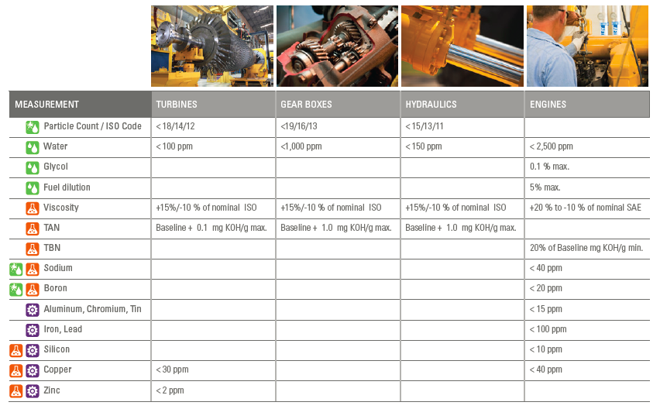
Typical limits for machinery types

Slide 5
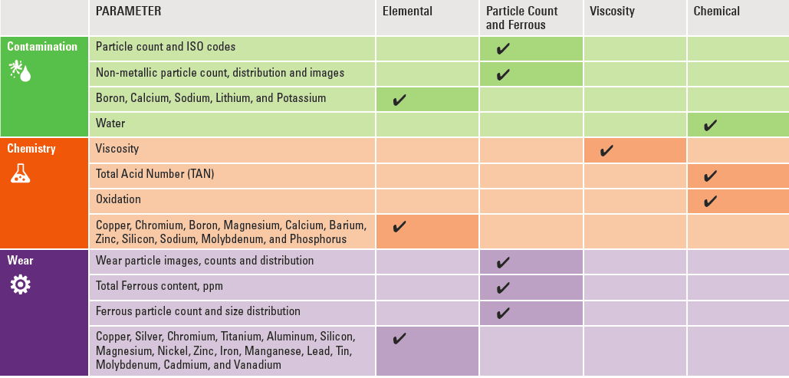
Key Analysis Parameters of the MiniLab 153

Slide 6
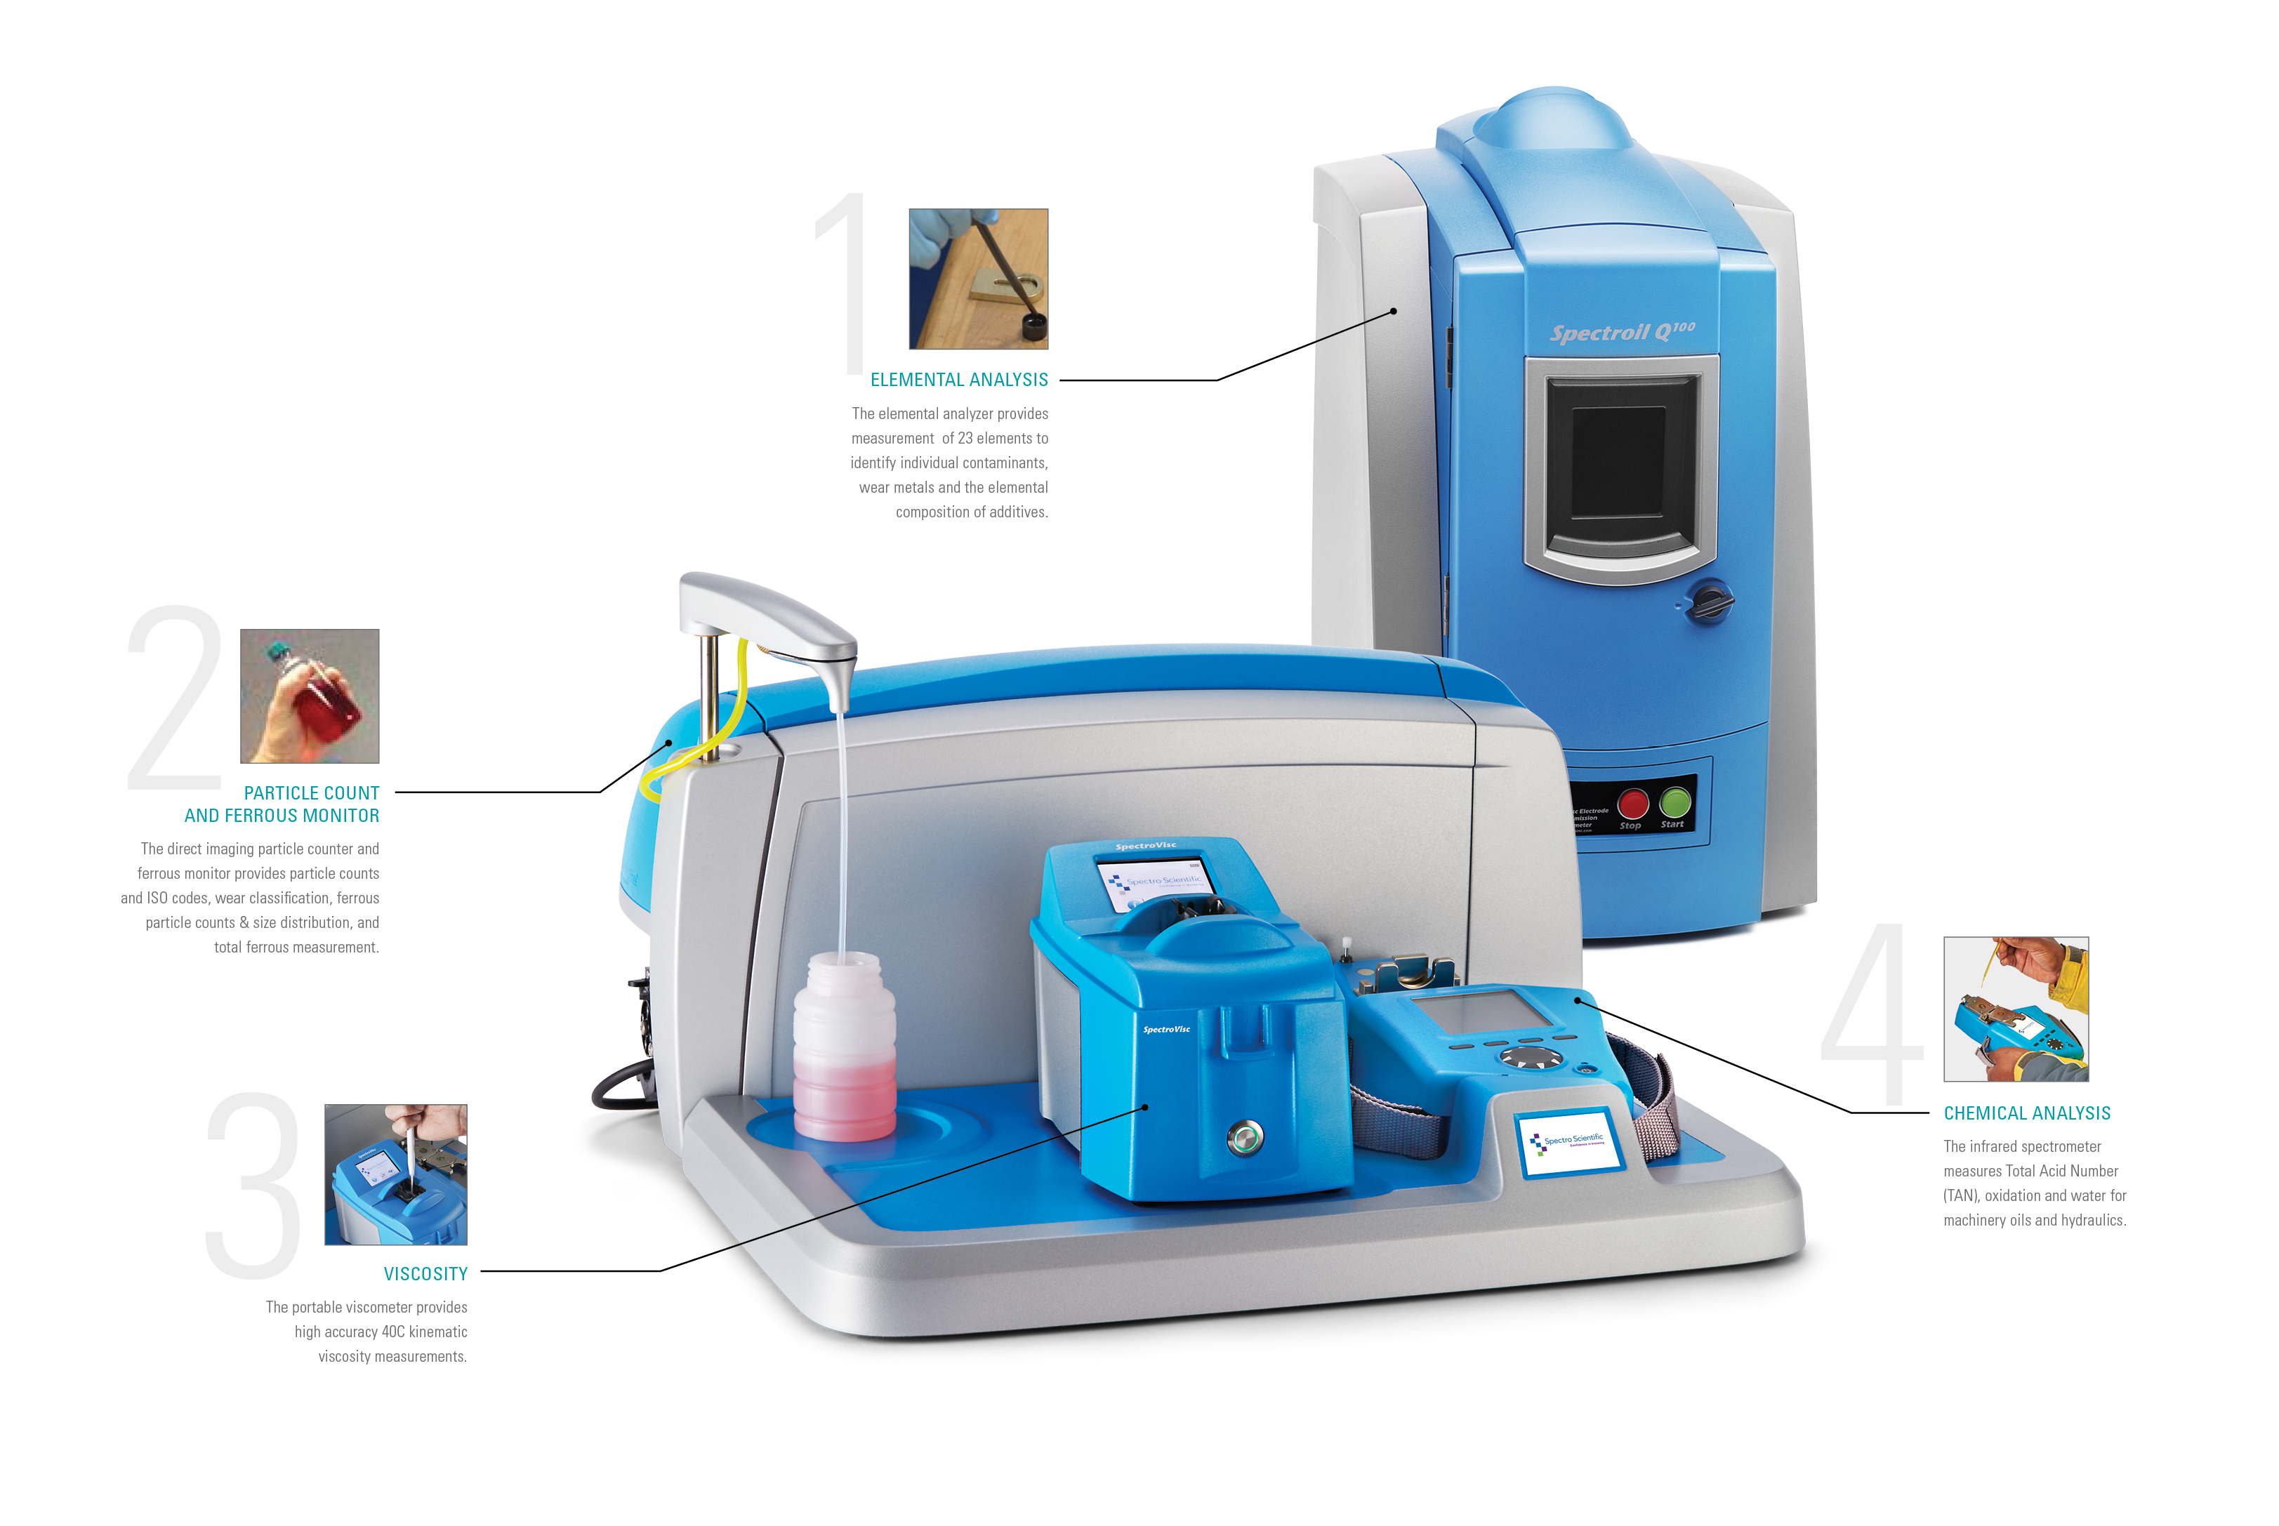
4 simple tests to quantify machinery health
MiniLab 153
Elemental Analysis
Particle Count and Ferrous
Chemical
Analysis
Viscosity

Slide 7
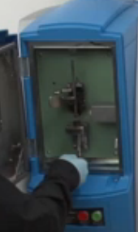
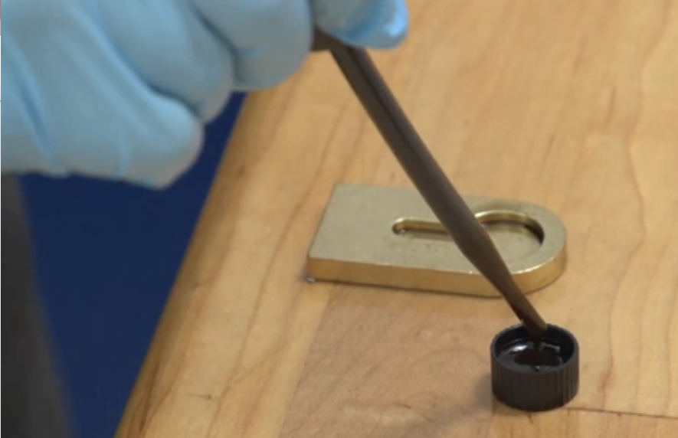
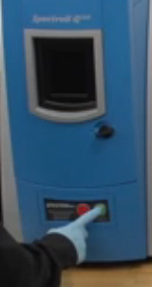
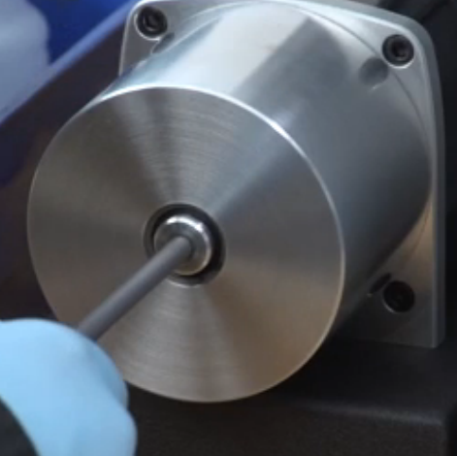
Four simple tests - Elemental Analysis
  Test 1: Elemental analysis
    Sharpen electrode and install with disk
    Pipette oil sample into cup
    Run sample
Sharpen electrode
Insert electrode and disk
Load sample into cup
Test

Slide 8
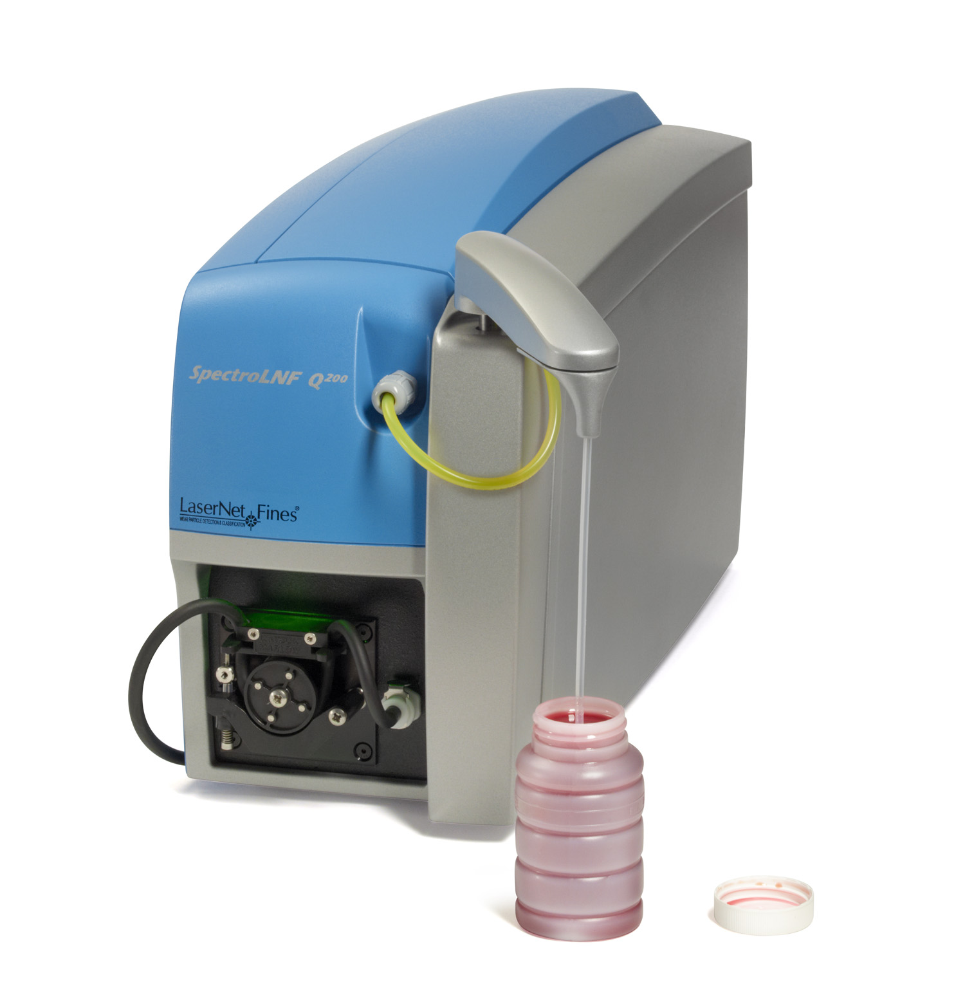
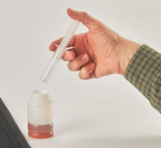
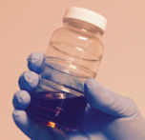
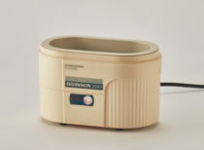
Four simple tests - Particle Count and Ferrous
  Test 2: Particle Count and Wear
    Dilute sample if viscosity >320 cSt
    Shake 30 seconds by hand
    30 seconds in ultrasound to remove bubbles
    3 minutes test through LNF particle analyzer
Dilute
Sample
Shake
by hand
Ultrasound
(deaeration)
Test

Slide 9
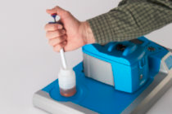
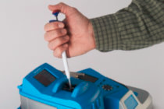
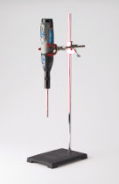
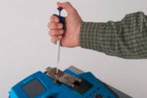
Four simple tests - Viscosity & Chemistry
Test 3: Viscosity
Pipette oil sample,drop 60 uL into viscometer with positive displacement pipette
Not homogenized
Test 4: Chemistry and Water
Homogenize sample, pipette 2 drops onto FluidScan
Homogenization finely disperses free water so it can be accurately measured by the FluidScan

Slide 10
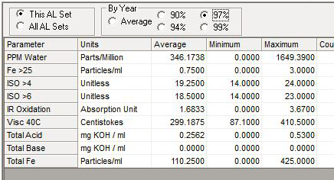
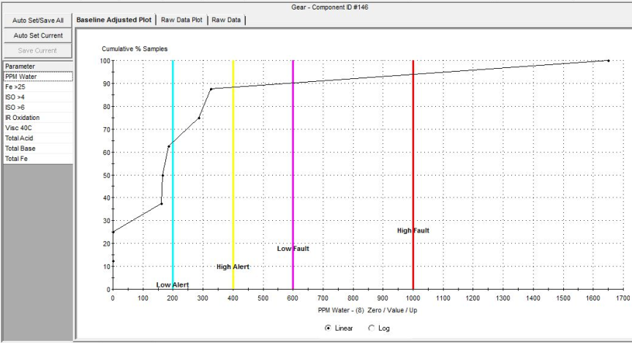
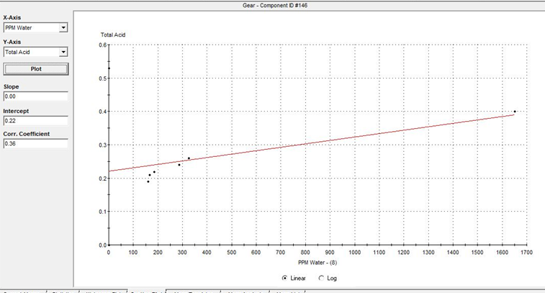
OilView Alarm analytics
Review Alarm history by individual component or class of components
Adjust initial alarm limits using the OilView cumulative probability distribution analysis capability
Analyze correlations between Analysis Parameters for insight into root cause

Slide 11
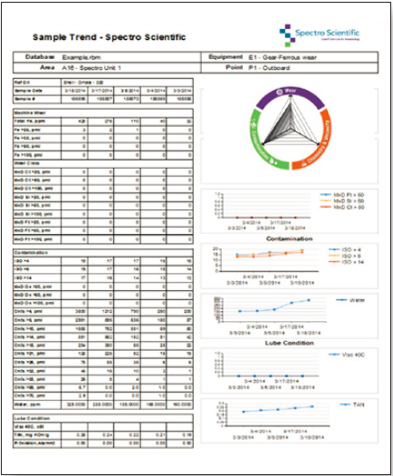
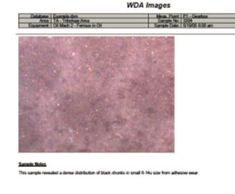
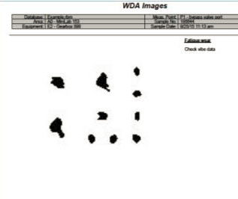
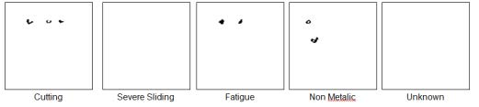
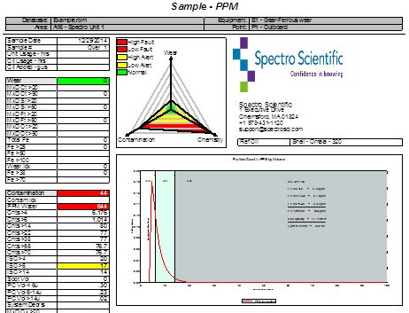
Trivector Reports
Trend Report with automatic import of Wear Image ‘thumbnails”
Optional WDA Module imports images from microscope camera or from LNF export file
-Export all images or filter by class
All traditional OilView
reports still available

Slide 12
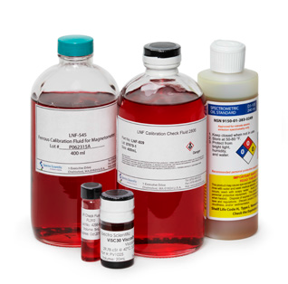
Performance verification with standard fluids
Particle count
LNF-509 calibration check fluid
Total Ferrous and Ferrous Particle Count
LNF-545 Ferrous Validation Standard for Magnetometer
  Total Ferrous Content, nominal 100 ppm
  Large Ferrous particle count, nominal 42 um particles
Elemental
CS-24 standard
Fluidscan IR check fluid
FL311 FluidScan Check Fluid
Viscosity standards
  PV1025 Visc 30 standard
  PV1026 Visc120 standard
NIST traceable standards and an ASTM method for instrumentation

Slide 13
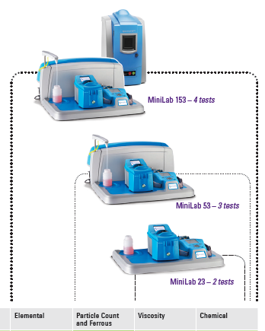
Minilab series configurations
Minilab 153
Minilab 53
Minilab 23
Three models with increasing capability

Slide 14
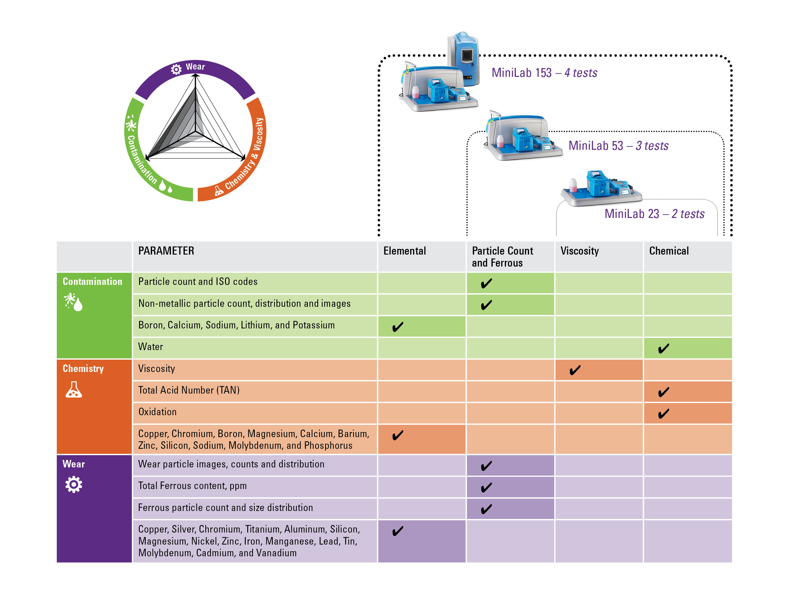
MiniLab parameters
A solution for every oil program with a clear upgrade path

Slide 15
Excellent repeatability of measurements for trending
 | Analytical Range | Repeatability
Particle Count | 4 um-100um | ± 6% RSD
Total Ferrous | 10 - 2,000 ppm | ± 5% RSD
Ferrous Particle Count | 25-100 um | ± 5% RSD
Viscosity (Low) | 1-320 cSt | ± 3% RSD
Viscosity (High) | 320-700 cSt | ± 5% RSD
TAN | 0-6 mg KOH/g | ± 3% RSD
Oxidation | 0-3 abs/mm2 | ± 3% RSD
Dissolved water | 200 ppm-saturation | ± 6% RSD
Free water | 0.1-6.5% (1,000-65,000 ppm) | ± 25% RSD
Elemental | Varies with element | Varies with element

Slide 16
Lab report vs. OilView® TriVectorTM report
 | Typical lab report | Trivector report
Elemental analysis | Yes
Particle count & ISO codes
Viscosity,40C
Water
TAN/TBN
Oxidation
Total Ferrous | PQ/DR ferrography | Fe in ppm
Large Fe count & distribution | DR ferrography | Fe distribution >20um
Analytical ferrography | Optional | Automated classification
Wear images | X | Yes
Wear classification (cutting, sliding, fatigue) | X | Trendable data
Non-metallic count & distribution | X | Trendable data
Simplified for on-site oil analysis - automated ferrography for the non-expert

Slide 17
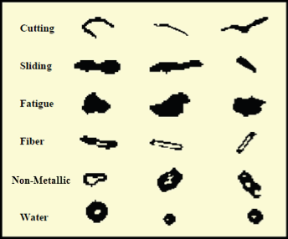
How does LNF particle analyzer work

Slide 18
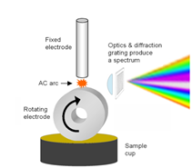
How does the RDE Elemental analyzer work
Oil sample is loaded into cup. Rotating disk carries oil into AC arc
Emission lines emitted representative of specific elements
Spectrum captured with CCD detectors

Slide 19
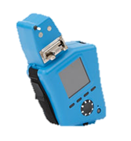
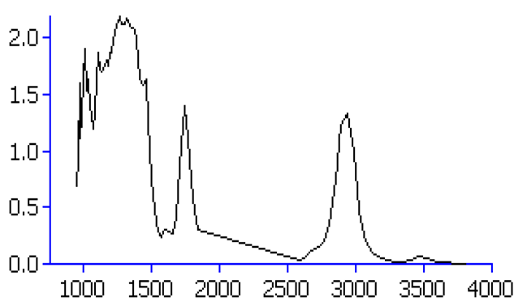
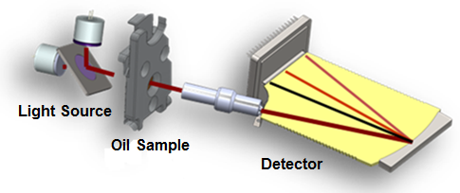
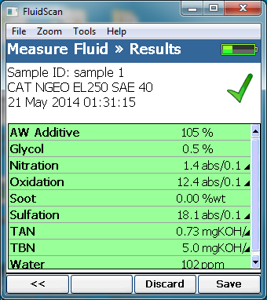
How does Fluidscan® work
IR Spectrum
Built-in Fluid Reference Library
Measured fluid properties

Slide 20
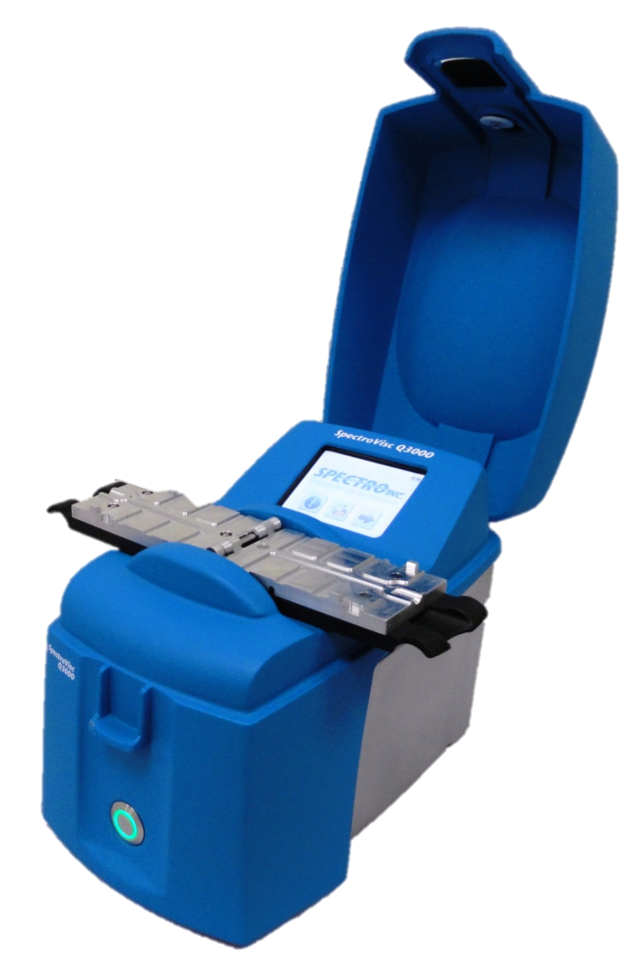
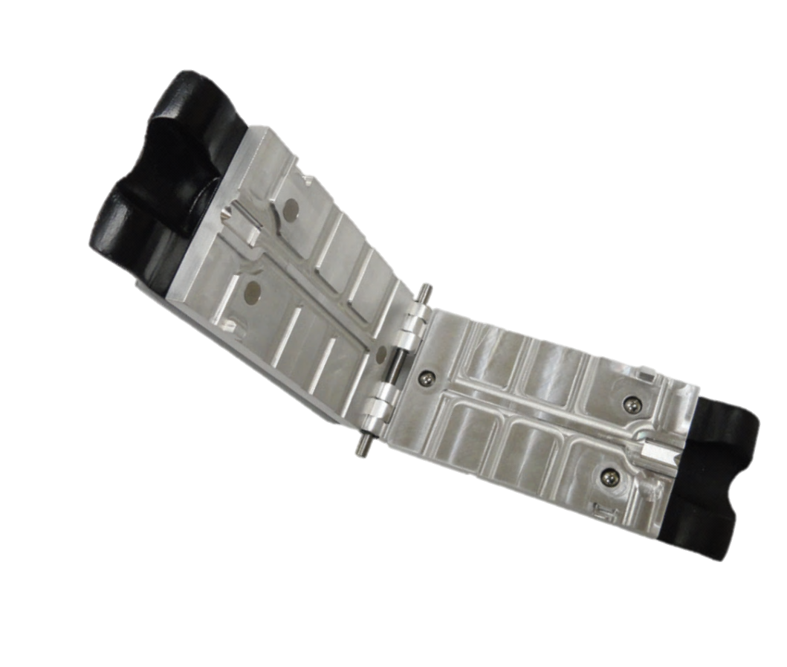
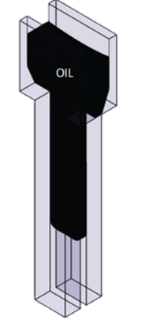
How does the viscometer work
Oil Flow by gravity
Time = t₀
Time = t₁
Temperature = 40C
Elapsed time for sample to travel under gravity down 40C heated cell is measured and the Kinematic Viscosity calculated
Viscosity= A* (t₁ - t₀) + B
  *A and B are calibration coefficients

Slide 21





MiniLab 153 analyses
The Infrared Spectrometer measures TAN (Total Acid Number), Water and Oxidation for machinery oils and hydraulics.
For engine oil it measures oxidation, nitration, sulfation, total base number (TBN), soot and water
The Optical Emission Spectrometer measures 23 elements: wear metals from mechanical components, elements in oil additives and contamination.
The Viscometer measures 40C kinematic viscosity.
It also calculates 100C viscosity using the Viscosity Index (VI).
The Particle Counter, Ferrous Monitor and Wear Classifier provides:
Particle Count & ISO Contamination Codes
Total Ferrous content and Ferrous particle count
Wear particle count and classification
21
21

Slide 22
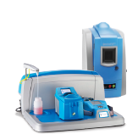
The MiniLab 153 delivers comprehensive on-site oil analysis with:
4 simple tests and results in < 20 minutes
Lab-quality analysis results in your plant
Simplified workflow for the non-expert user
Trivector reports with immediate actionable results
Full integration to AMS OilView software

